Slide 1
App Store Data Challenge
By: Jason Yang
Friday, March 4th, 2022

Slide 2

Introduction
Jason Yang
Data Science Manager – Urgently Roadside
1 year: ranking & pricing model deployment
Data Scientist – InMarket Media
3 years: audience segmentation, propensity models, incremental lift, campaign analytics
Product Support Engineer – OSIsoft (AVEVA)
2 years: time-series database tech support

Slide 3
Executive Summary
Background on data
Recommendation: Opportunity to lower or eliminate the cost barrier to PMOF apps, especially for Games category
July 4th increased consumable transaction by 12.1%
Data quality: “unknown” payment type & data gap
Extra
PMOF & Free only account creations
Unsupervised account clustering

Slide 4
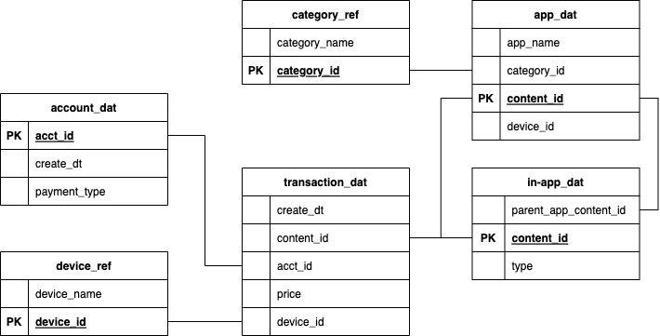
Data

Slide 5
Data
“Download”
Consumable
Subscription

Slide 6
Data

Slide 7
Data
Entertainment
Games
Photos & Videos
Social Networking
Utilities
Free only
PMOF
“unknown”

Slide 8
Assumptions
Real App Store data from June 2016 to September 2016
Apple Arcade (2019) subscription not available
“Price == 0” app transactions by PMOF are part of a pilot project
Term: “free app download”

Slide 9
Objective: Increase access to great apps and content at an affordable price

Slide 10
Pay to Win
Users are paying a lot of money in Games apps
Pay-to-Win mechanisms:
Tasks take a long time
Pay-only content
Unable to make progress
Impossible to without paying
Great content, but not affordable

Slide 11
Free, But Not as Good?
Free accounts download at least 2x more apps than PMOF accounts
Potential bad experiences:
Lots of Ads
Unsupported App (no revenue)
Bad App
Affordable, but mediocre

Slide 12
Pilot Project
Remove the download cost barrier to 13 Games apps for PMOF accounts
Why? Cost limits both developers and users. Removing the download cost will help us observe the potential of paid apps
Create an environment to
Support developers to create great apps
Access great apps at an affordable price

Slide 13
Free, But Not as Good?
Free accounts download at least 2x more apps than PMOF accounts
Potential bad experiences:
Lots of Ads
Unsupported App (no revenue)
Bad App

Slide 14
PMOF Account Download Time Series

Slide 15
PMOF Account Download Time Series

Slide 16
PMOF Account Game App Downloads

Slide 17
Game App Comparison
A PMOF app without cost barrier has 10x more accounts
Lowering cost barrier to PMOF apps can increase usage to be above Free only apps

Slide 18
Takeaway 1
Objective: Great apps deliver great content at an affordable price
PMOF apps have great content with high usage cost
Free only apps have mediocre content
Recommendation
Lower or eliminate the cost barrier to PMOF apps, especially for Games category

Slide 19
July 4th Spike

Slide 20
July 4th – Only Holiday Spike

Slide 21
Increased Consumable Transactions
About 12.1% increase in transactions/account
About 1.3% decrease in price/transaction

Slide 22
Takeaway 2
We observed a spike in consumable transactions on July 4th.
No other spikes in other holidays
Does not appear to be due to pricing discounts
Recommendation
Inconclusive. Need to find other variables to explain the spike on July 4th

Slide 23
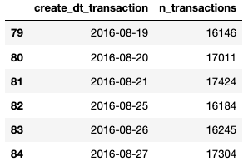
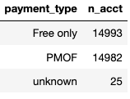
Data Quality Issues
25 acct_id’s without payment_type
data gap on 2016-08-22 to 2016-08-24

Slide 24
Future Analysis
I want to do a deeper analysis with more data including:
App usage metrics like crashes, duration, and rating
Better define what a “good” app
Account attributes like age and demographics
Audience segmentations for accounts

Slide 25
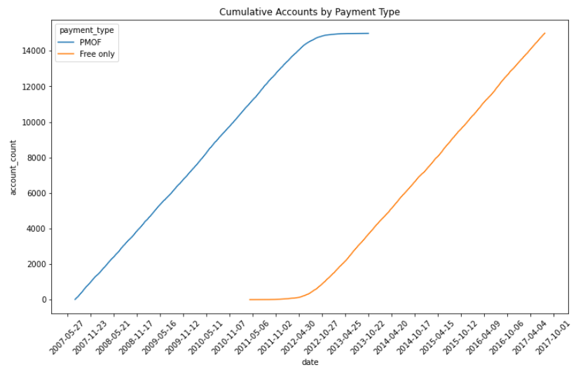
Extra: Account Creation

Slide 26
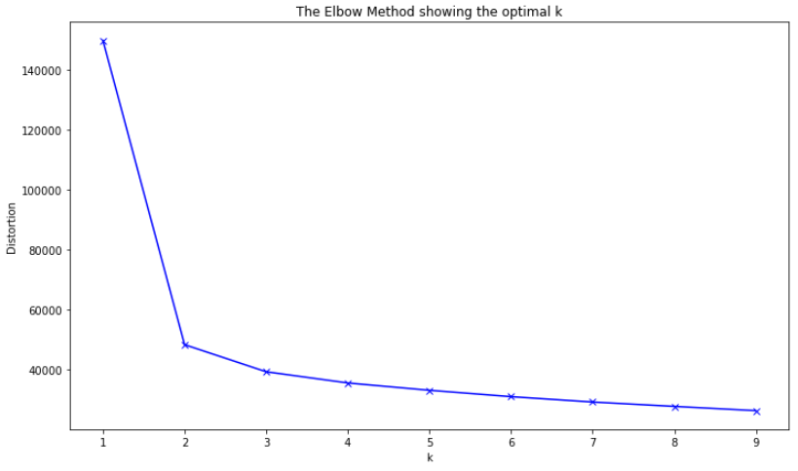
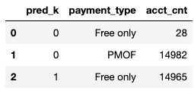
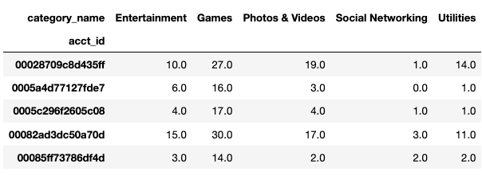
Extra: Account Clustering

Slide 27
Questions & Answers

Slide 28
Thank you

